Slide 1



Learn 2gether
01

Slide 2

Problem Statement
Isolation in Learning: Many students struggle alone without peer support.
Lack of Engagement: Traditional e-learning platforms are passive and lack interactivity.
Difficulty Finding Study Partners: Students often need help but don’t know where to find study buddies.
Time Management Issues: Learners struggle to stay consistent and track progress effectively.
02

Slide 3

Solution
Learn 2gether is an interactive platform where learners:
✔ Join shared study groups based on subjects or goals.
✔ Engage in live virtual study rooms with video, chat, and whiteboards.
✔ Find peer tutors for 1-on-1 or group learning.
✔ Track progress with AI-powered study planners & analytics.
✔ Access crowdsourced notes, quizzes, and resources.
03

Slide 4
Product
Study Groups & Forums—topic-based communities for discussions.
Virtual Study Rooms—Live sessions with screen-sharing & collaboration tools.
Peer Tutoring Marketplace—Students teach & earn; others learn affordably.
Smart Study Planner – AI schedules study sessions with accountability reminders.
Gamified Progress Tracking—Badges, streaks, and leaderboards to motivate users.
04

Slide 5



Target Market
4 out 5
Students (High School, College, Grad School)
Tutors & Educators (Monetizing knowledge)
75%
Professionals (Upskilling/Certification Seekers)
05

Slide 6
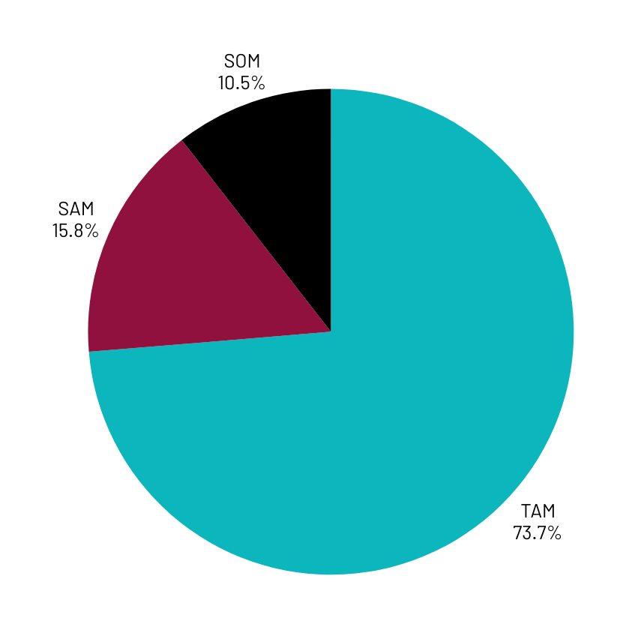
Market Size
Total Addressable Market (TAM): $10B+ Global e-learning market.
Serviceable Available Market (SAM): $2B Peer learning & tutoring segment.
Serviceable Obtainable Market (SOM): $200M Initial focus on US, Africa, UK learners.

Slide 7
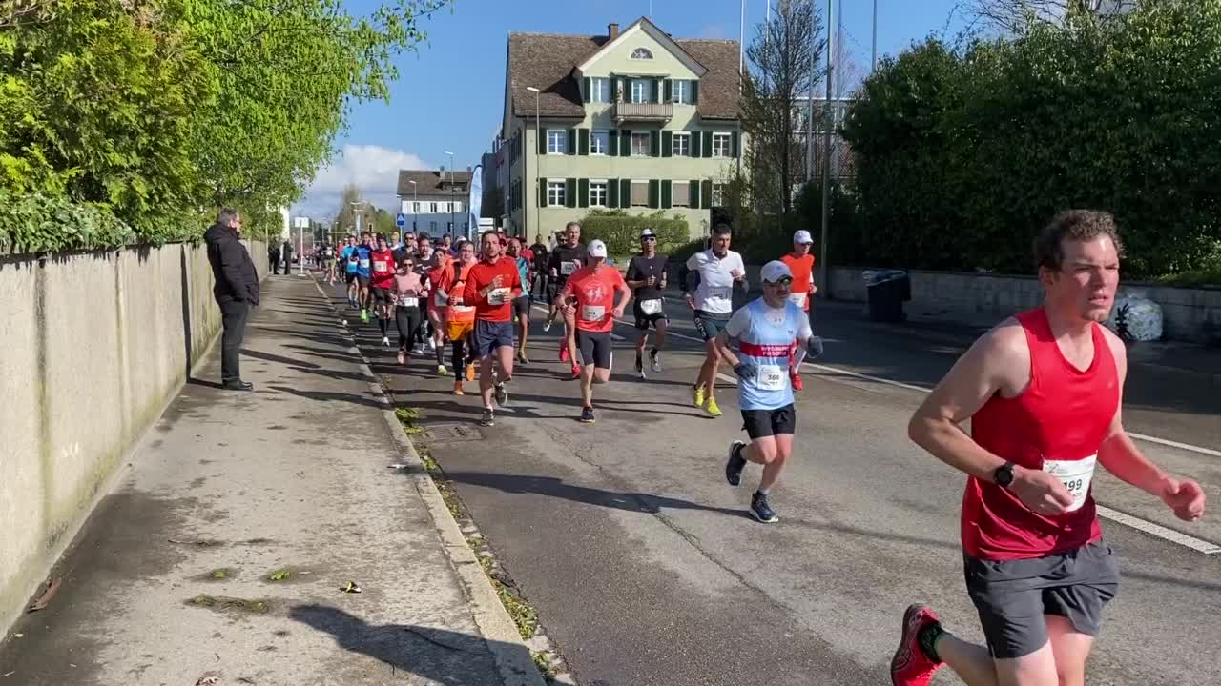
Competitors
Competitors | What They Offer | Gap Learn 2gether Fills
Tuteria | One-on-one tutor matching; in-person and online sessions; Nigeria-focused | Limited to Nigeria; Larn2gether can scale regionally and support broader peer collaboration
Instill Education | Teacher training platform for African educators | Not student-facing; Larn2gether provides student empowerment and learning autonomy
Digemy | Corporate gamified training and analytics | Not academic; Larn2gether addresses student tutoring and social learning
07

Slide 8

Competitive Advantage
Build for Learning - Not just communication, but structured study tools
Peer Tutoring Economy - Students earn while helping others
AI-Powered Accountability
Smart reminders
Progress tracking
Gamification - Motivates consistent learning habits

Slide 9
Project Traction
June
July
Aug
Sep
Tasks
Week 5
Week 1-2
Week 2 -3
Week 2 -5
Oct - Nov
Conducr Market Research
Define Product Features
MVP Development
10 000 Waitlidting Signups
University Partnerships
Monetization Testing
Global Expansion
09

Slide 10

Subscription-Based Model
Basic Plan: Free for the first trial
Standard Plan: $4/month per student
Institutional Plan: $100/month per institution
Tutor Commission: 10% fee per 2 sessions )
Profit Margin
Targeted Revenue:
1,000 students × $4/month × 12 months =
$48,000
10 institutions × $100/month × 12 months =
$12,000
$2000/month x 12 months = $24,000/year
$48,000 + $12,000 + $24,000 = $84,000
Total Profit = $84,000 - $20,000 = $64,000
Profit Margin = ($84,000 / $20,000) × 100 = 76,2%
Business Model
10

Slide 11
Go To Market
Phase 1: University partnerships (Student orgs, educators).
Phase 2: Social media and influencer marketing (TikTok, Instagram).
Phase 3: SEO and referral programmers (invite friends, get rewards).

Slide 12
Social Impact
SDG 4: Quality Education
Provides accessible, affordable peer learning for students.
SDG 5: Gender Equality
Encourage female participation in STEM and leadership via study groups.
SDG 8: Decent Work and Economic Growth
Empowers tutors, especially students and unemployed youth, to earn an income.
SDG 10: Reduced Inequalities
Supports rural and low-income students with offline features.

Slide 13
Our Ask
💡 Seeking $500K Seed Funding
60% Product Development
20% Marketing & User Acquisition
10% Operations
10% Team Expansion
Expected Milestones:
50K users in 12 months
Monetization by Q3 2025

Slide 14


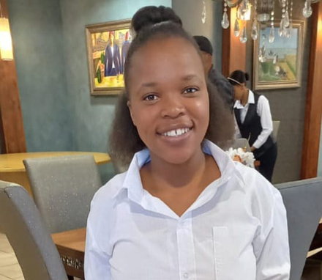
Team Members
THEBE LIYABINA
NZIPO SIYABONGA
VUYO KEBE
Technical Lead
Project Coordinator
Outreach Coordinator

Slide 15



Thank you!
📧 Contact: liyabona.thebe@gmail.com
"Alone we can learn, but together we master."
15

